Slide 1
STRINGS
UNIT 3

Slide 2
STRINGS
In Python strings are simple text consisting of sequence of characters, letters, numbers, and special characters. Strings can be created using single quotes, double quotes and triple quotes. Using triple quotes, strings can span several lines without using the escape character.
Example:
>>> str1='Python is a simple and easy language' #String with single quote
>>> str2=”Python is free and open source software” #String with double quote
>>> str3="""Python is a high level language""" #String with triple quote
>>>print(str1)
Python is a simple and easy language
>>>print(str2)
Python is free and open source software
>>>print(str3)
Python is a high level language

Slide 3
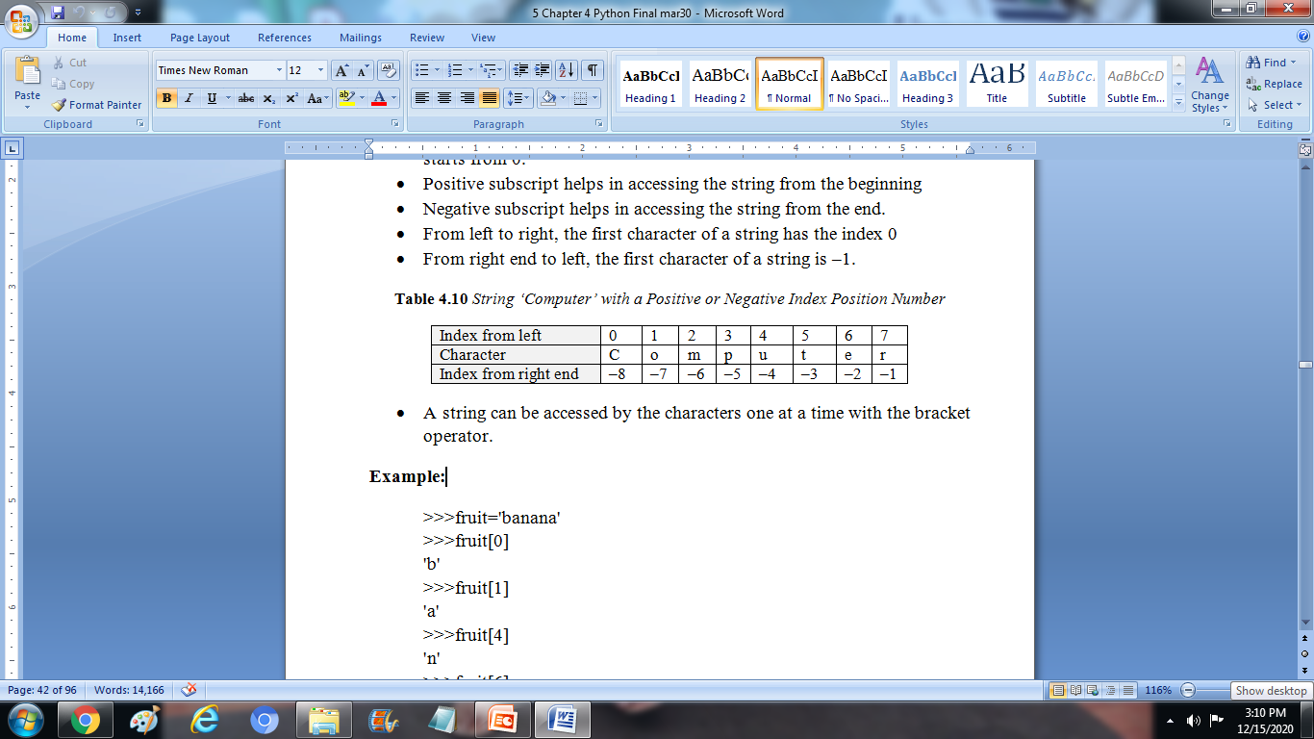
Accessing String Elements
An individual character in a string is accessed using a subscript (index). The subscript should always be an integer (positive or negative). A subscript starts from 0.
Positive subscript helps in accessing the string from the beginning
Negative subscript helps in accessing the string from the end.
From left to right, the first character of a string has the index 0
From right end to left, the first character of a string is –1.
String ‘Computer’ with a Positive or Negative Index Position Number

Slide 4
A string can be accessed by the characters one at a time with the bracket operator.
Example:
>>>fruit='banana'
>>>fruit[0]
'b'
>>>fruit[1]
'a'
>>>fruit[4]
'n'
>>>fruit[6]
Traceback (most recent call last):
File "<pyshell#15>", line 1, in <module>
fruit[6]
IndexError: string index out of range
>>>fruit[5]
'a‘
>>>fruit[−5]
'a'
>>>fruit[−4]
'n'
>>>fruit[−2]
'n'
>>>fruit[−1]
'a'
>>>fruit[0]
'b'

Slide 5
Traversing a string
Traversing a string means accessing all the elements of the string one after the other by using the subscript. A string can be traversed using: for loop or while loop.
Traversal with a for loop
On execution of the for loop, the characters in the string are printed till the end of the string is not reached.
Example:
>>>bird = 'parrot'
>>>for letter in bird:
print(letter)
Output:
p
a
r
r
o
t
Each time in loop, the next character in the string is assigned to the variable letter. The loop continues until no characters are left.

Slide 6
Traversal with a while loop
The len() function calculates the length of the string. On entering the while loop, the interpreter checks the condition. If the condition is true, it enters the loop. The first character in the string is displayed. The value i is incremented by 1. The loop continues till value i is less than len−1.
Example:
>>>bird = 'parrot'
>>>i=0
>>>while i<len(bird):
letter=bird[i]
print(letter)
i=i+1
Output:
p
a
r
r
o
t
This loop traverses the string and displays each letter on a line by itself.

Slide 7
STRING SLICES
A segment of a string is called a slice. Selecting a slice is similar to selecting a character. Subsets of strings can be taken using the slice operator with two indices in square brackets separated by a colon ([ ] and [m:n]).
The operator [m:n] returns the part of the string from the m^{th} character to the n^{th} character, including the first but excluding the last.
Example:
>>>a='Python Programming'
>>>a[0:5]
'Pytho'
>>>a[:5]
'Pytho'
>>>a[5:]
'n Programming'
>>>a[5:10]
'n Pro'
>>>a[:]
'Python Programming‘

Slide 8
STRINGS ARE IMMUTABLE
Strings are immutable, which means we cannot change an existing string. But a new string can be created from the variation on the original string.
Example:
>>>word='red'
>>>word='b'+word[:2]+'a'+word[2:]
>>>word
'bread'
This example concatenates the new first and fourth letters onto a slice of string 'red'. It has no effect on the original string.
To verify this by trying to update a part of the string which will led us to an error.

Slide 9
Program :
string="python"
string[0]="P"
print("string = ",string)
Output:
Traceback (most recent call last):
File"C:/Users/admin/AppData/Local/Programs/Python/Python36-32/immutable1.py", line 2, in <module>
string[0]="P"
TypeError: 'str' object does not support item assignment
The above program shows the error indicating that we cannot change an existing string. But a new string can be created from the variation on the original string.

Slide 10
Program :
string="python"
new_string=string.replace('p','P')
print("string = ",string)
print("new string = ",new_string)
Output:
string = python
new string = Python
In the above program the new string is created by replacing lowercase letter ‘p’ with uppercase letter ‘P’. It has no effect on the original string.

Slide 11
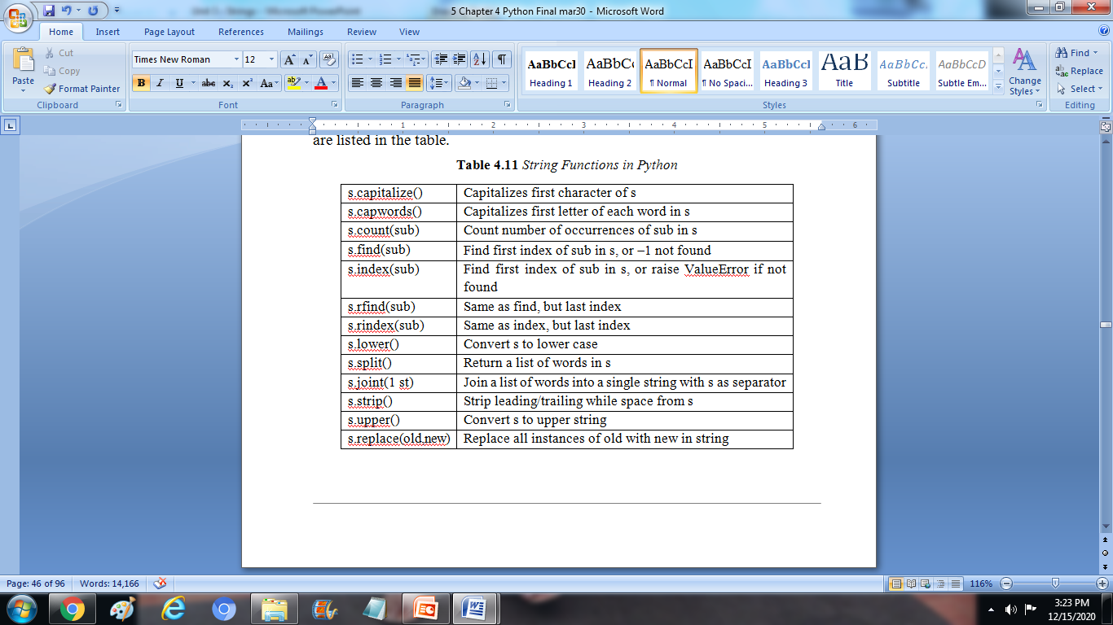
STRING FUNCTIONS AND METHODS
Strings provide methods to perform a variety of useful operations. A method is similar to a function. It takes arguments and returns a value.

Slide 12
Upper
The method upper takes a string and returns a new string with all uppercase letters.
Example:
>>>word='python programming'
>>>newword=word.upper()
>>>newword
'PYTHON PROGRAMMING'
This form of dot notation specifies the name of the method, ‘upper’ and the name of the string, to apply the method to ‘word’. The empty parentheses indicate that this method takes no arguments.
A method call is called an invocation. So, it is invoking ‘upper’ on ‘word’.

Slide 13
Lower
The method ‘lower’ takes a string and returns a new string with all lowercase letters.
Example:
>>>word='PYTHON PROGRAMMING'
>>>newword=word.lower()
>>>newword
'python programming'

Slide 14
Capitalize, Split
Capitalize
The ‘capitalize’ function capitalizes the first character of s.
Example:
>>>s='python'
>>>s.capitalize()
'Python’
Split
The ‘split’ function strip leading or trailing white space from a string.
Example:
>>>s='python programming'
>>>s.split()
['python', 'programming']

Slide 15
Find
The ‘find’ method can find substrings in a string.
>>>word='python programming'
>>>newword=word.find('pro')
>>>newword
7
Here the ‘find’ method searches from the first and finds the string which starts at pro and returns index 7 as parameter.
>>>newword=word.find('pro',3)
>>>newword
7
Here the find method searches from the 3rd index and finds the string which starts at pro and returns index 7 as parameter.
>>>newword=word.find('ram',7, 15)
>>>newword
11
Here the find method searches from the 7th index to 15th index and finds the string starts at pro and returns index 11 as parameter.
>>>newword=word.find('rem',7, 15)
>>>newword
−1
Here the search fails. So the ‘find’ function returns −1 as parameter.

Slide 16
The in operator
The word in is a boolean operator that takes two strings and returns ‘True’ if the first appears as a substring in the second.
Example:
>>>'ra' in 'parrot'
False
>>>'ro' in 'parrot'
True
Python sometimes reads like English. That is, “for (each) letter in (the first) word, if (the) letter (appears) in (the second) word, print (the) letter.”
Example:
>>>def in_both(word1, word2):
for letter in word1:
if letter in word2:
print(letter)
>>>in_both('jovita', 'jesvita')
J
v
i
t
a

Slide 17
String Concatenation
The + operator performs string concatenation, which means it joins the strings by linking them end-to-end.
Example:
>>>first='problem'
>>>second='solving'
>>>first+second
'problemsolving'
Repetition
The * operator performs repetition on strings.
Example:
>>>a='Hello'
>>>a*5
'HelloHelloHelloHelloHello'

Slide 18
String Length
The len function returns the number of characters in a string.
Example:
>>>s='problem solving'
>>>len(s)
15
String comparison
The relational operators work on strings. The relational operators are used to compare two strings.
Example:
>>>if 'python'= = 'python':
print('Both strings are equal')
Both strings are equal

Slide 19
STRING MODULE
The string module provides additional tools to manipulate strings. Some methods available in the standard data structure are not available in the string module (e.g., isalpha).
Example:
>>>import string
>>>string.digits
'0123456789'
>>>string.ascii_letters
'abcdefghijklmnopqrstuvwxyzABCDEFGHIJKLM
NOPQRSTUVWXYZ'
>>>string.ascii_lowercase
'abcdefghijklmnopqrstuvwxyz'
>>>string.ascii_uppercase
'ABCDEFGHIJKLMNOPQRSTUVWXYZ'
>>>string.hexdigits
'0123456789abcdefABCDEF'
>>>string.octdigits
'01234567'
>>>string.punctuation
'!"#$%&\'()*+,−./:;<=>?@[\\]^_`{|}~'
>>>string.printable
'0123456789abcdefghijklmnopqrstuvwxyzABCDE
FGHIJKLMNOPQRSTUVWXYZ!"#$%&\'()*+,−./:;
<=>?@[\\]^_`{|}~ \t\n\r\x0b\x0c'
>>>string.whitespace
'\t\n\r\x0b\x0c'
>>>string.capwords("python")
'Python'

Slide 20
LISTS AS ARRAYS
Creating fixed size list is similar to creating array in other programming languages. The typical Python solution is to use the repetition operator and a list containing the value None:
Example:
>>>a = [None]*5
>>>a
[None, None, None, None, None]
The variable is now a list with five elements, but the positions do not yet have any useful value stored in them.

Slide 21
In some applications the array will hold numeric data, and zero is a more appropriate initial value.
Example:
>>>data = [0]*5
A two dimensional array is usually represented in Python by a list of lists. However, the initialization of such a value is not as easy as the initialization of a one-dimensional list.
Example:
>>>a='none'
>>>data=[a]*5
>>>data
['none', 'none', 'none', 'none', 'none']
>>>for i in range(0,5):
data[i]=[0]*5
>>>data
[[0, 0, 0, 0, 0], [0, 0, 0, 0, 0], [0, 0, 0, 0, 0], [0, 0, 0, 0, 0],[0, 0, 0, 0, 0]]
>>>data[2][2]=7
>>>data
[[0, 0, 0, 0, 0], [0, 0, 0, 0, 0], [0, 0, 7, 0, 0], [0, 0, 0, 0, 0],[0, 0, 0, 0, 0]]

Slide 22
A root of the polynomial p is a solution to the equation p = 0, i.e., an r such that p(r) = 0. So, for example, the problem of finding an approximation to the square root of 24 can be formulated as finding an x such that x² – 24 ≈ 0.
Newton proved a theorem that implies that if a value, call it ‘guess’, is an approximation to a root of a polynomial, then guess – p(guess)/p'(guess), where p' is the first derivative of p, is a better approximation.
For any constant k and any coefficient c, the first derivative of cx² + k is 2cx. For example, the first derivative of x² – k is 2x. Therefore, we know that we can improve on the current guess, call it y, by choosing our next guess as y − (y²− k)/2y. This is called successive approximation

Slide 23
Program :
# Program to quickly find an approximation to the square root.
epsilon = 0.01
k = float(input("Enter a k to find square root: "))
guess = k/2.0
while abs(guess*guess – k) >= epsilon:
guess = guess – (((guess**2) – k)/(2*guess))
print ('Square root of', k, 'is about', guess)
Output:
Enter a k to find square root: 24
Square root of 24.0 is about 4.8989887432139305

Slide 24
Thank You

